Slide 1
HACKATHON
Hack For Hire
[Kakud Agri ]
Team Name | : | Code Crafters.
Team Members | : | 1) Mohammed Rayan 2) Anvith D B 3) Akash Shreekant Hegde 4) N P Satvik

Slide 2
Problem Statement
Cross-City Vehicle Booking Web App Challenge Statement
Content
Design and develop an innovative web application for booking vehicles travelling between cities. The web app should display all available vehicles traveling on the same route, providing users with a seamless and efficient booking experience.

Slide 3
Cross-City Vehicle Booking Web App Challenge Statement
It simplifies the process of finding and booking transportation between cities, eliminating the need to research and compare different rental car companies or public transportation options.
It helps the users to easily find the vehicle type to carry his product from one place to another.

Slide 4
Solution Overview
User friendly interface.
Options to specify pick-up and drop-off Locations.
Provide a high-level description of how your solution addresses the problem.
User Authentication: Secure login for personalized access.
Booking Details: Specify pickup/drop-off locations, product type, and size.
Vehicle Recommendation: Suggests the best vehicle based on user needs.
Pricing: Calculates estimated costs for informed decision-making.
Trading Platform: Enables vehicle and service trading for added flexibility.

Slide 5
Key Features
User Authentication:
Secure login system for personalized and secure access.
Booking Details:
Inputs for specifying pickup and drop-off locations.
Options to select the type and size of the product to be transported.
Vehicle Recommendation:
Automated suggestions for the most suitable vehicle based on user inputs.
Pricing:
Real-time price calculation for transparency and informed decision-making.
Trading Platform:
A module that allows users to trade vehicles and services.

Slide 6
Technology Stack
Frontend Development:
HTML5/CSS3: For structuring and styling web pages.
JavaScript/TypeScript: For adding interactivity and ensuring type safety.
Backend Development:
PHP: A Server Side Scripting Language.
Database Management:
MySQL: Relational databases for structured data storage.

Slide 7
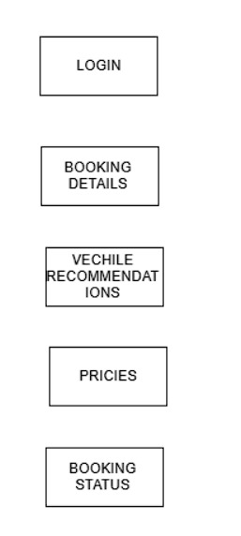
Architecture Diagram

Slide 8
Use Cases
Corporate Relocations:
Efficient vehicle selection and tracking.
E-commerce Shipments:
Accurate vehicle choices and real-time tracking.
Personal Moves:
Simple booking and cost clarity.
Event Logistics:
Optimal vehicle recommendations and tracking.
Vehicle Trading:
Secure trading platform.

Slide 9
Impact and Benefits
Faster Booking: Reduced time.
Higher Satisfaction: Better ratings.
Costs: Decreased expenses.
Increased Utilization: More efficient vehicle use.
More Trades: Higher trading volume.

Slide 10
Challenges and Lessons
.
.
Early Testing: Crucial for addressing issues.
Scalable Architecture: Essential for future growth.
User Feedback: Improves design and usability.
Security: Implement strong measures from the beginning.
Teamwork: Effective communication and organization are vital

Slide 11
Conclusion
Our solution effectively addresses the Cross-City Vehicle Booking Web App Challenge by providing a streamlined, user-friendly platform for vehicle bookings. We successfully tackled challenges related to real-time features, database scalability, and user interface design, learning valuable lessons about the importance of early testing, scalability, usability, security, and clear communication.

